Slide 1
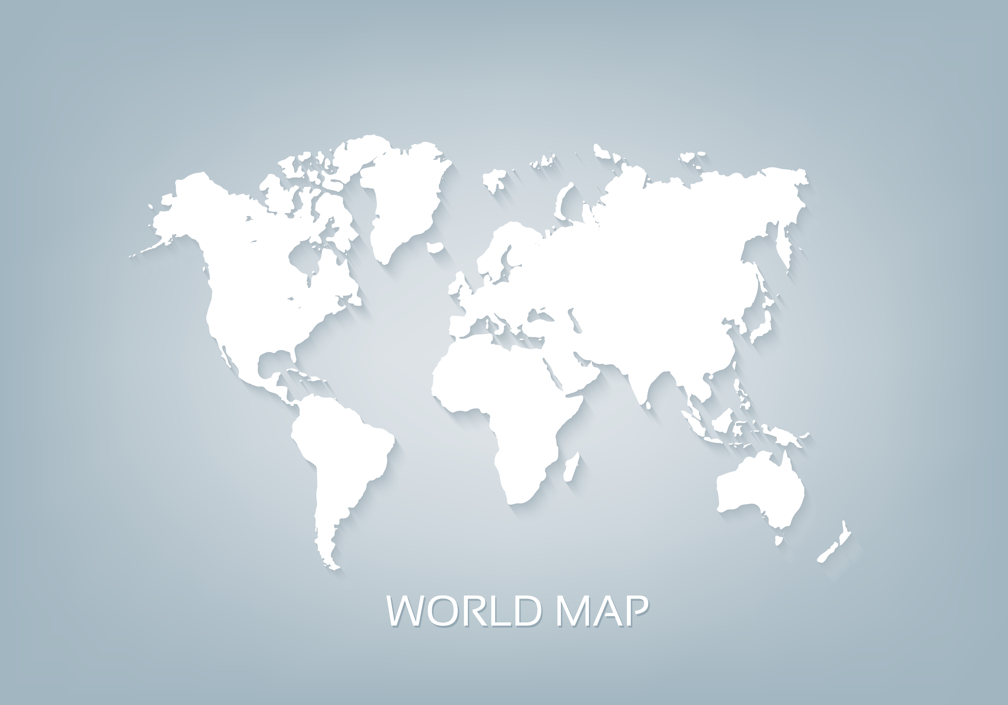
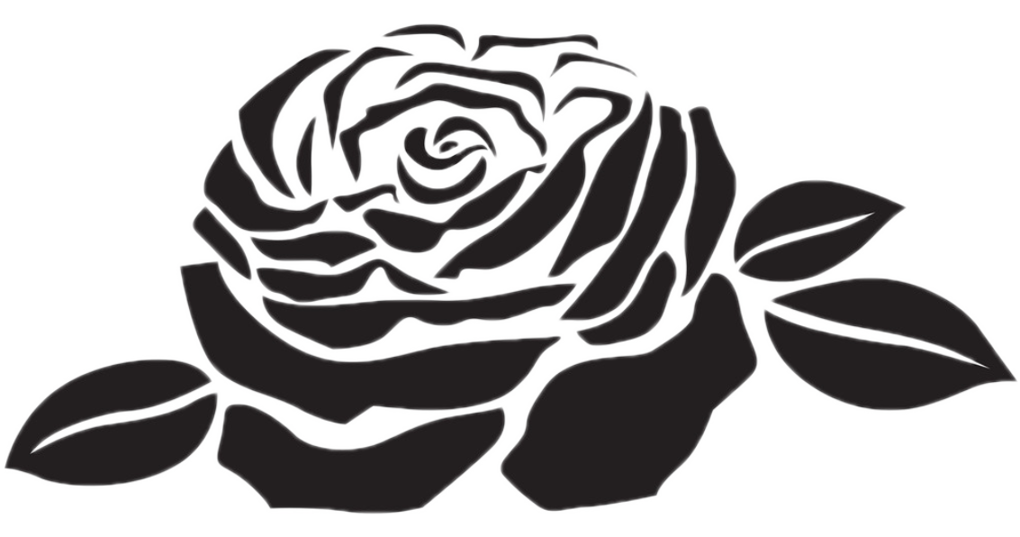

Bloom
Group members
刘琦琦
李乐晨 周富琦 武世豪
陈雙筑 韦美伶 孟庆丰

Slide 2
Bloom
Cultural
different
dress
dinner
festival
travelling
wedding

Slide 3
Bloom
Festival
Chinese Festivals
Festival Comparison
Foreign Festivals

Slide 4
Catalog
Ⅰ Chinese Festivals
① MENG Tomb-Sweeping Day
② CHEN The Mid-Autumn Festivals
Ⅱ Foreign Festivals
①LIU Canada's Maple Syrup Day
②LI Easter Day
Ⅲ Festival Comparison
③WU Eid al-Fitr & Chinese New Year
①ZHOU St. Patrick's Day & The Dragon Boat Festival
②WEI Valentine’s Day & Double Seventh Festival

Slide 5
Chinese Festivals
Tomb-Sweeping Day
The Mid-Autumn Festivals

Slide 6
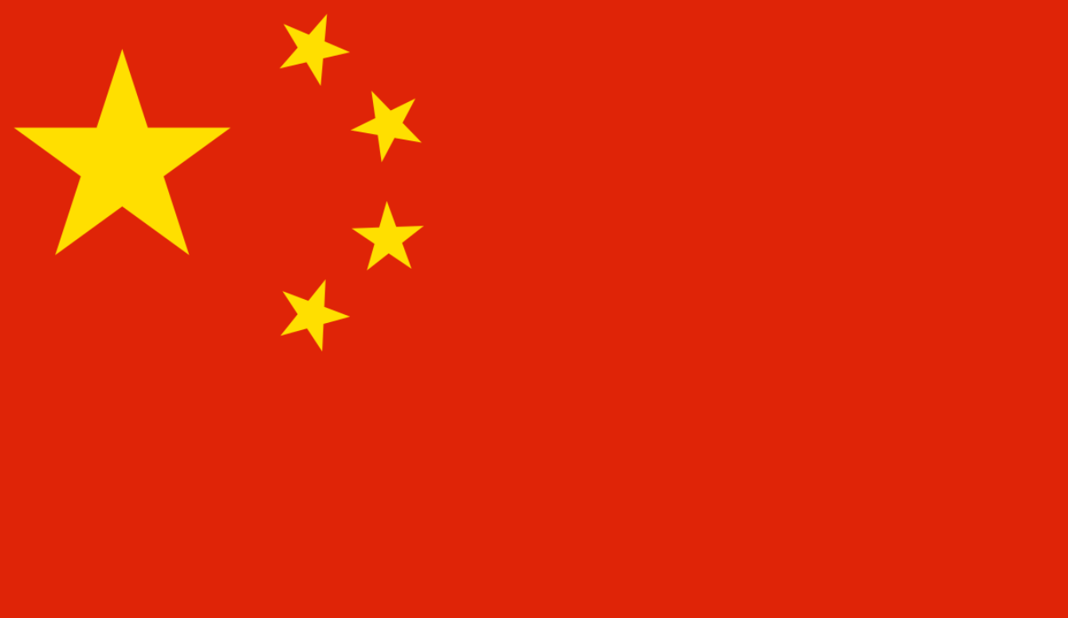
Tomb-Sweeping Day
Ⅰ Chinese Festivals
① MENG
② CHEN
Ⅱ Foreign Festivals
①LIU
②LI
Ⅲ Festival Comparison
③WU
①ZHOU
②WEI
Not only is it a day for commemorating the dead, is it also a time for people to enjoy themselves. During March, everything in nature takes on a new look, as trees turn green, flowers blossom, and the sun shines brightly. It is a fine time to go out and to appreciate the beautiful scenes of nature.
Notes:
图片缺失

Slide 7
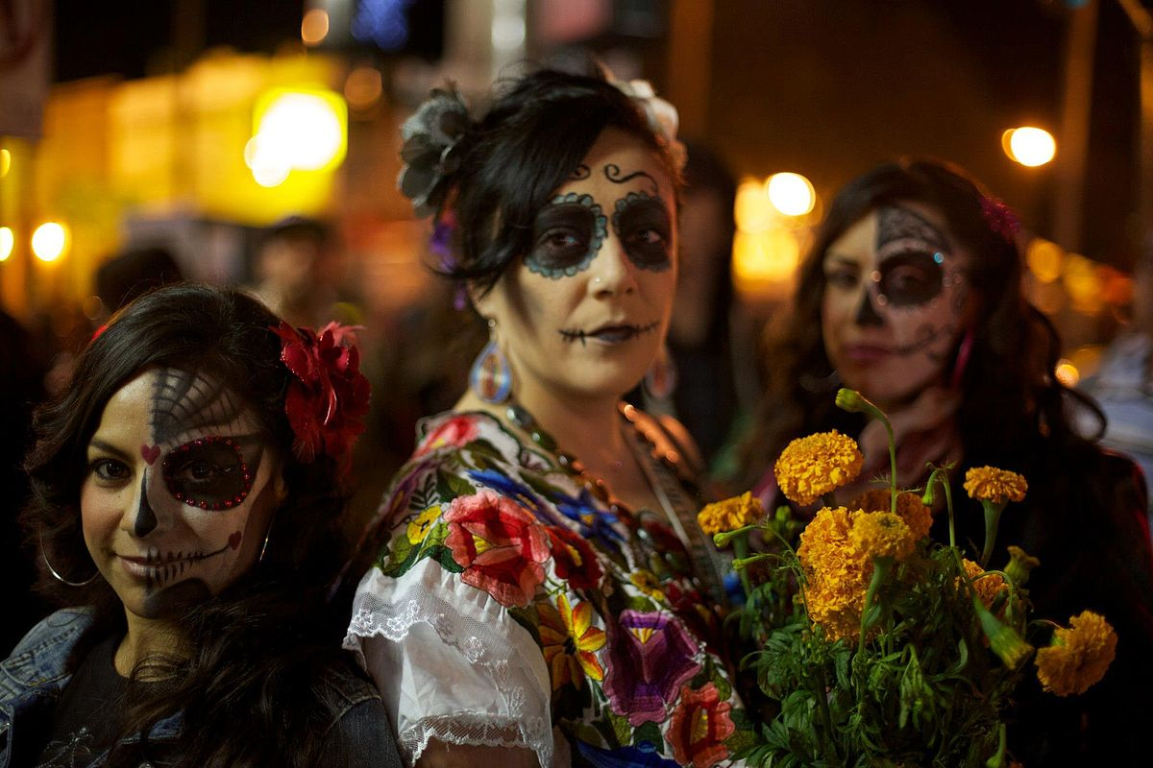
Tomb-Sweeping Day
Ⅰ Chinese Festivals
① MENG
② CHEN
Ⅱ Foreign Festivals
①LIU
②LI
Ⅲ Festival Comparison
③WU
①ZHOU
②WEI
When we think of Qingming Festival, we first think of tomb-sweeping, honoring our ancestors, but that's not everything. In Mexico, there is a traditional holiday called Día de Muertos. The Day of the Dead. This festival is all about pray for and remember friends and family members who have died. But the Qingming Festival is different. It has many other customs.
The Day of the Dead

Slide 8
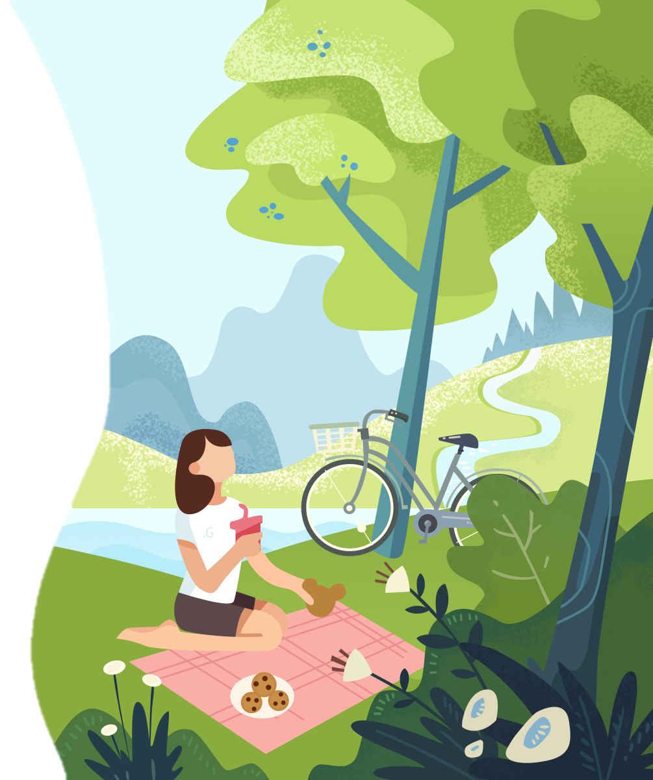

Tomb-Sweeping Day
Ⅰ Chinese Festivals
① MENG
② CHEN
Ⅱ Foreign Festivals
①LIU
②LI
Ⅲ Festival Comparison
③WU
①ZHOU
②WEI
Not only is it a day for commemorating the dead, is it also a time for people to enjoy themselves. During March, everything in nature takes on a new look, as trees turn green, flowers blossom, and the sun shines brightly. It is a fine time to go out and to appreciate the beautiful scenes of nature.

Slide 9
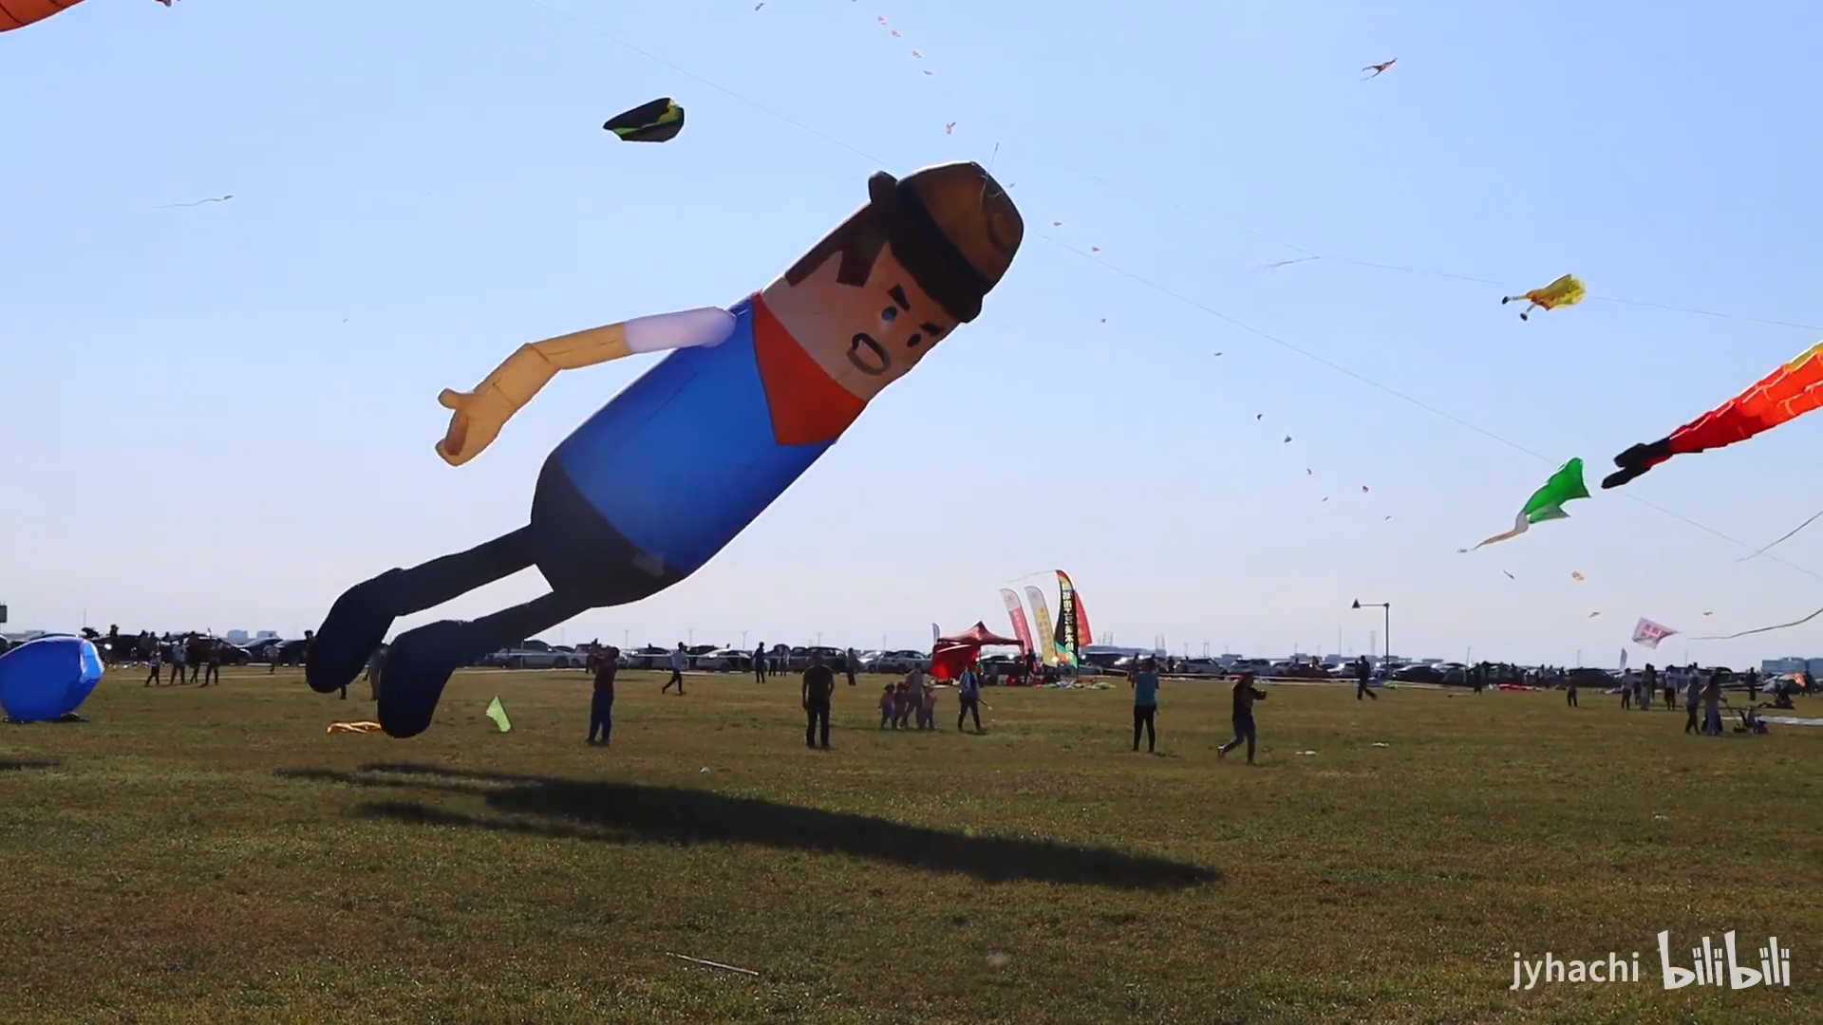
Tomb-Sweeping Day
Ⅰ Chinese Festivals
① MENG
② CHEN
Ⅱ Foreign Festivals
①LIU
②LI
Ⅲ Festival Comparison
③WU
①ZHOU
②WEI
Flying Kites
Flying kites is an activity favored by many people during the Qingming Festival. Kites are not only flown during the day time but also in the evening. Little lanterns are tied to the kite or to the string that holds the kite. And when the kite is flying in the sky, the lanterns look like twinkling stars that add unique scenery to the sky during the night.

Slide 10
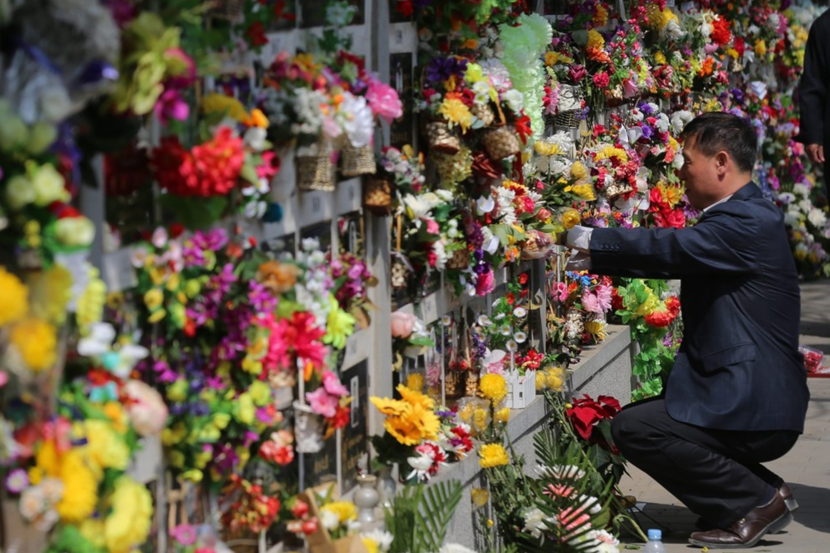
Tomb-Sweeping Day
Ⅰ Chinese Festivals
① MENG
② CHEN
Ⅱ Foreign Festivals
①LIU
②LI
Ⅲ Festival Comparison
③WU
①ZHOU
②WEI
Tomb sweeping is regarded as the most important custom in the Qingming Festival from which the name of Tomb-sweeping day is got. Cleaning the tomb and paying respect to the dead person with offerings are the two important parts of remembering the past relatives. The dead person's favourite food and wine are taken to sacrifice to them, along with paper resembling money. This is all burned in the hope that the deceased are not lacking food and money.

Slide 11
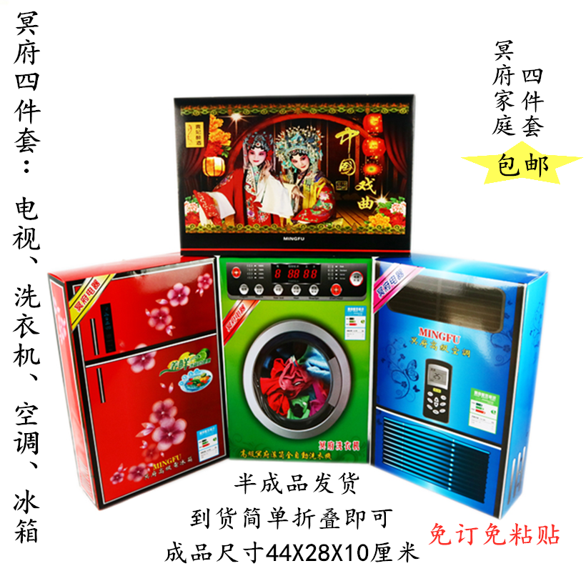
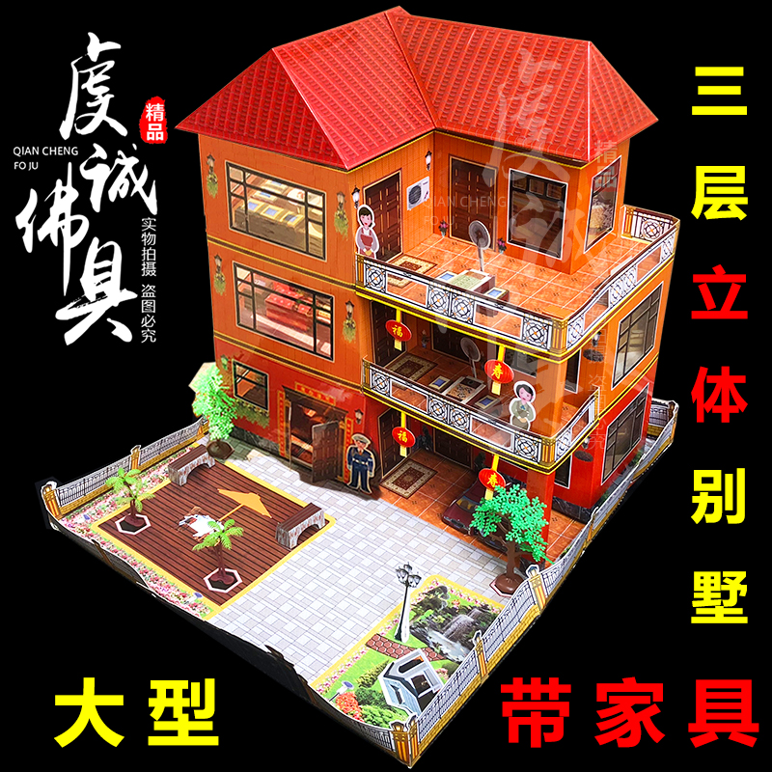
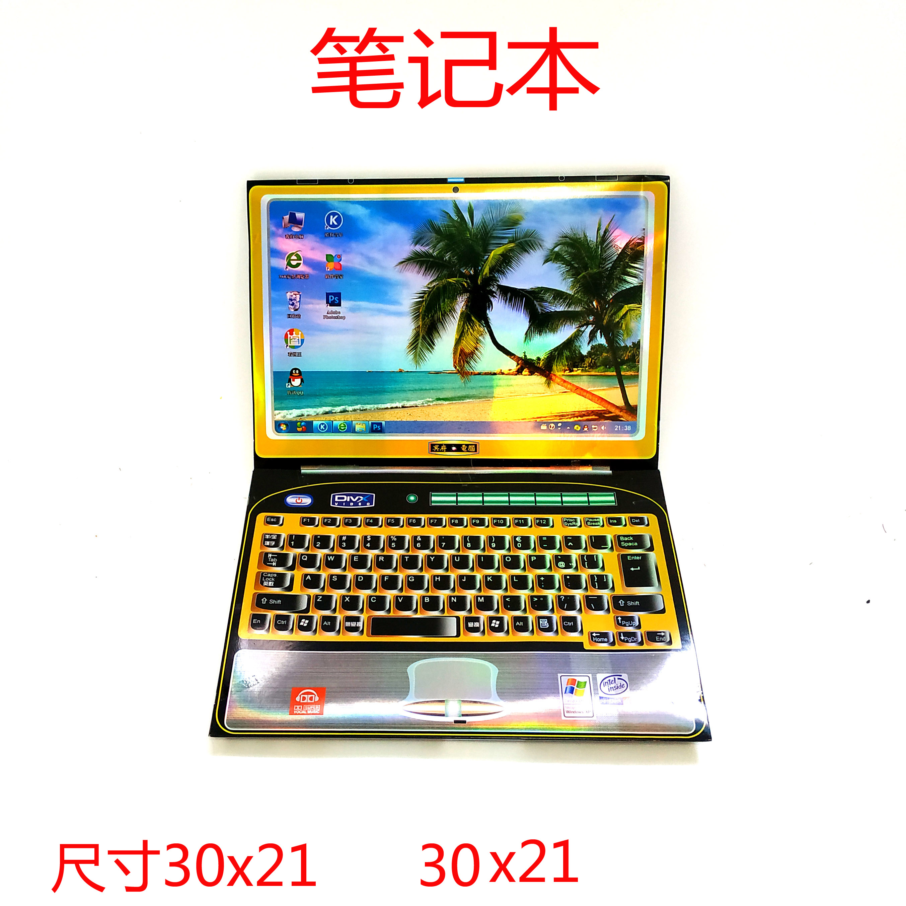
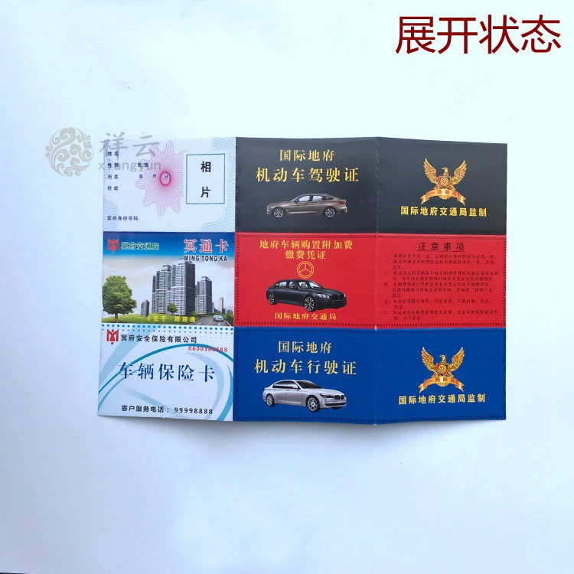
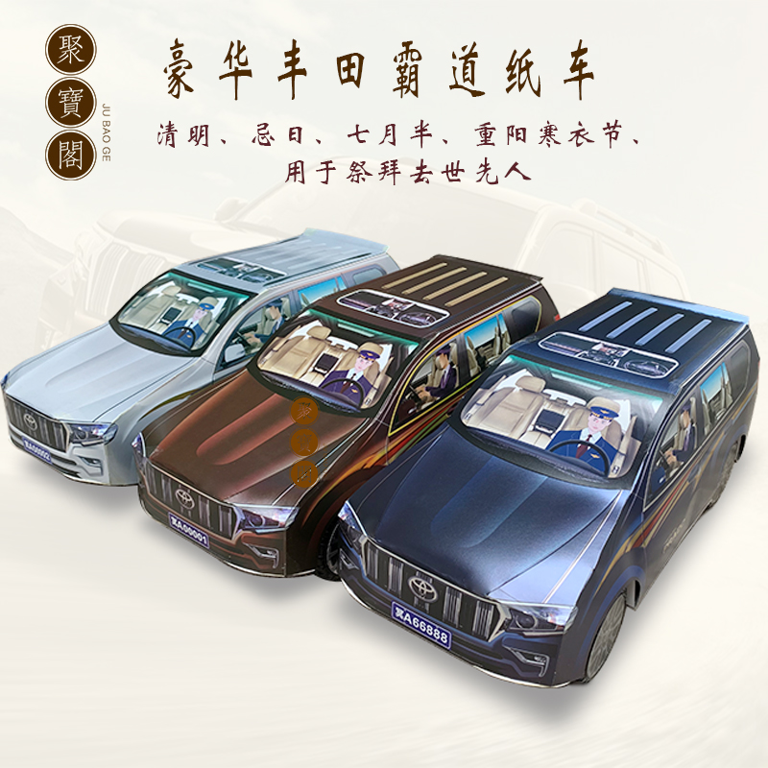
Tomb-Sweeping Day
Ⅰ Chinese Festivals
① MENG
② CHEN
Ⅱ Foreign Festivals
①LIU
②LI
Ⅲ Festival Comparison
③WU
①ZHOU
②WEI

Slide 12
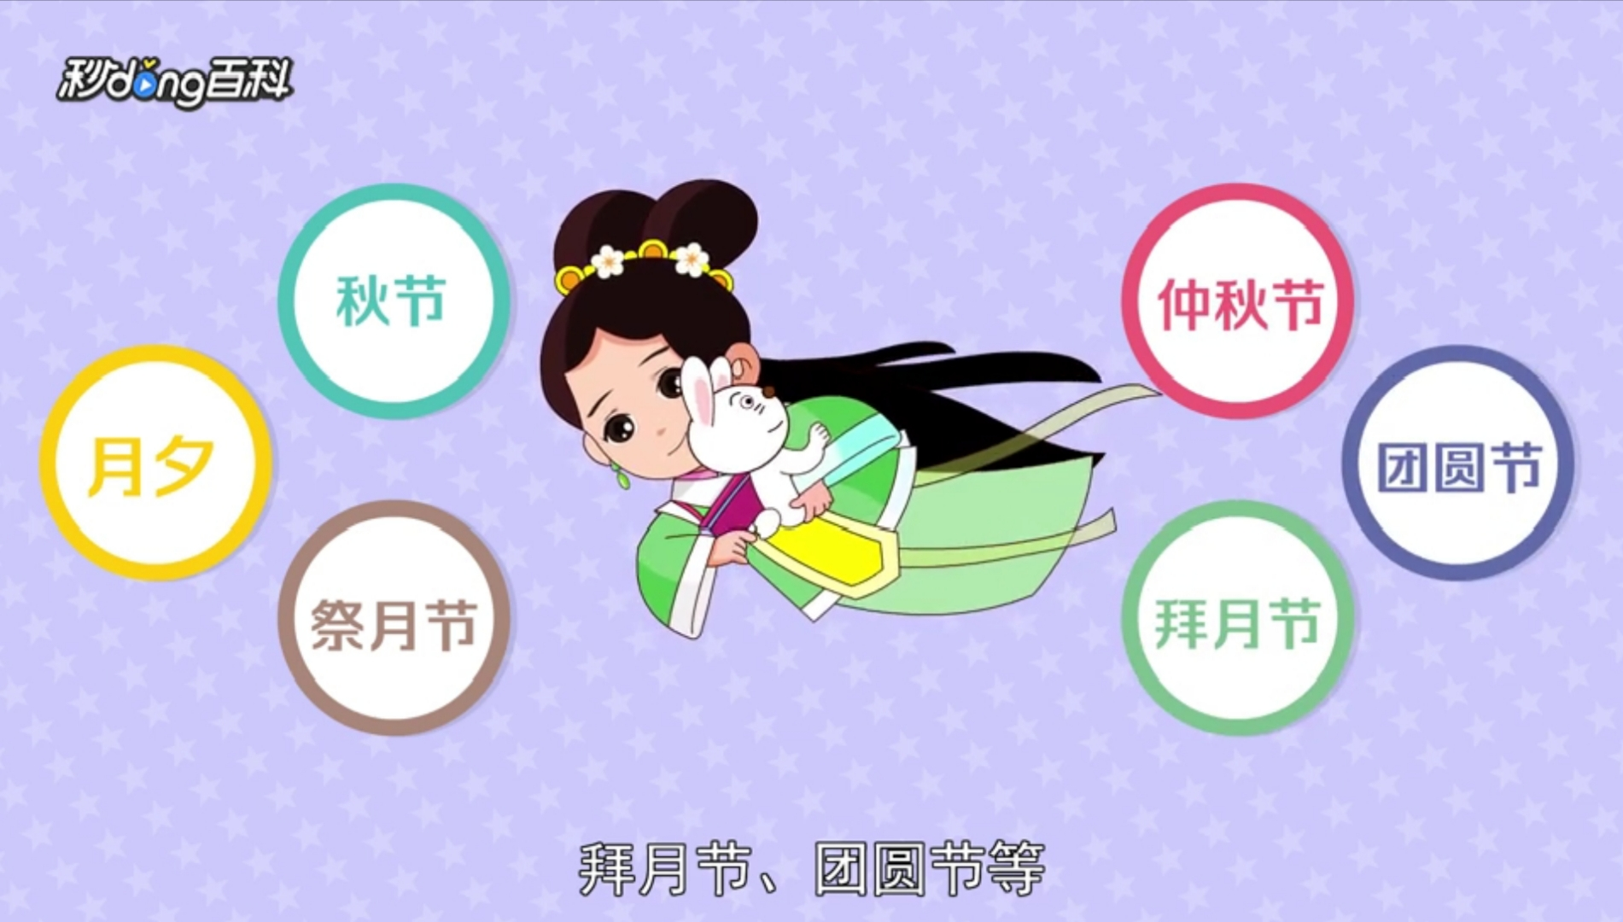
The Mid-Autumn Festival
Ⅰ Chinese Festivals
① MENG
② CHEN
Ⅱ Foreign Festivals
①LIU
②LI
Ⅲ Festival Comparison
③WU
①ZHOU
②WEI
One of the four traditional festivals
Also known as the festival of sacrifice
,Yuexi, Zhongqiu Festival, Reunion Festival
Time: August the 15th (Chinese Lunar Calendar)

Slide 13
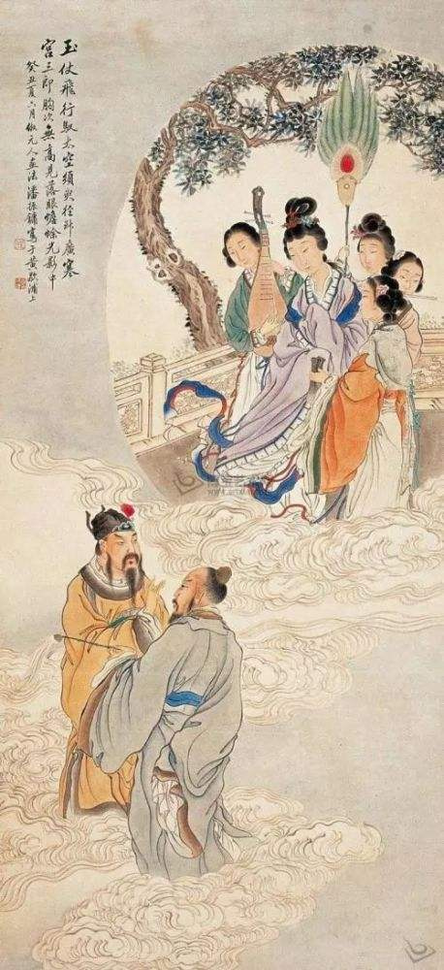
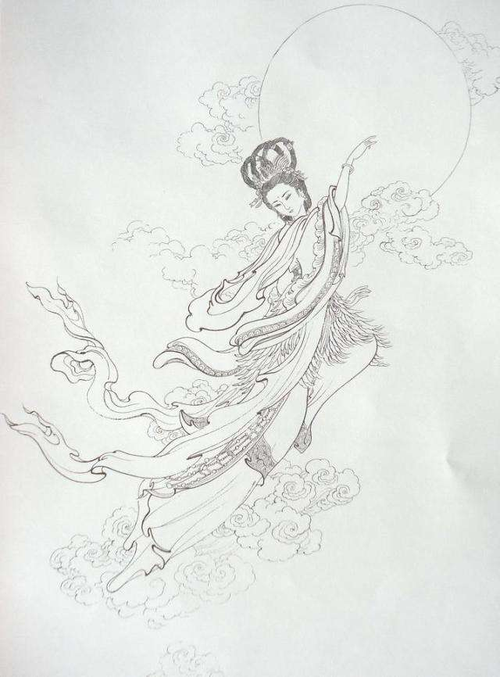
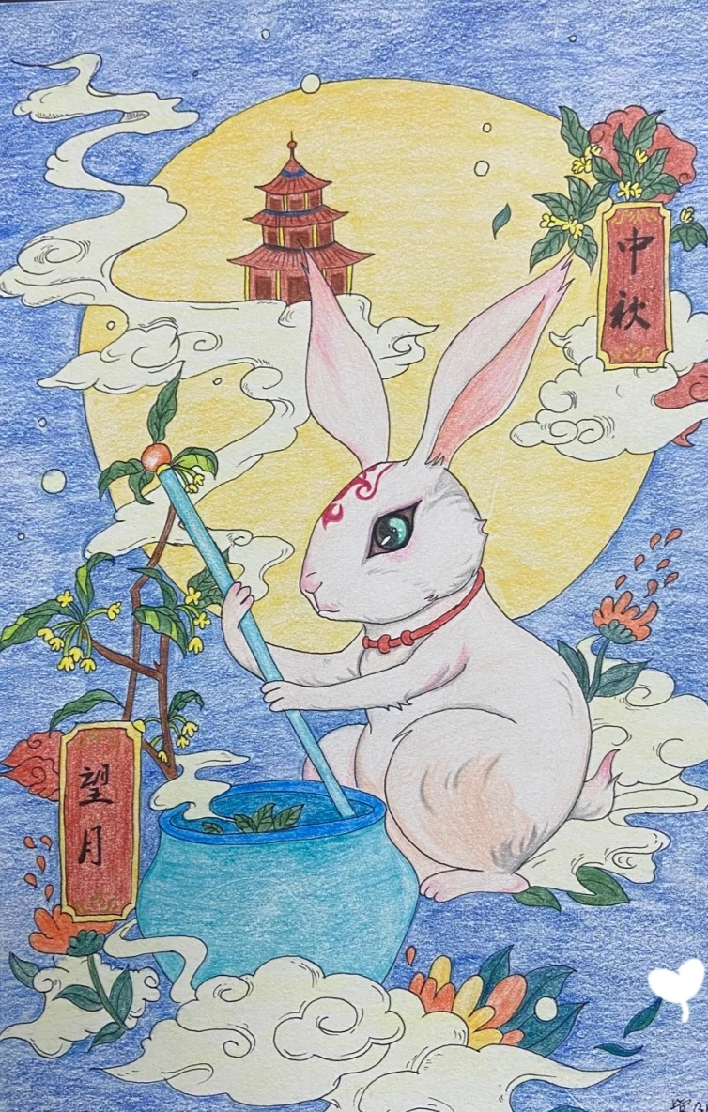
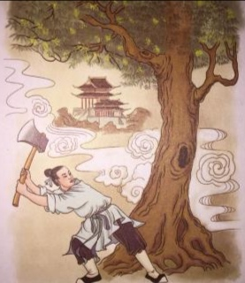
The Mid-Autumn Festival
Ⅰ Chinese Festivals
① MENG
② CHEN
Ⅱ Foreign Festivals
①LIU
②LI
Ⅲ Festival Comparison
③WU
①ZHOU
②WEI
Folklore（民间传说）
The Goddess Chang’s fly to the moon
Wu Gang chops down the cassia tree（吴刚伐桂）
Xuanzong visited the Moon Places（玄宗游月宫）
Moon Rabbit Grinding Medicine（玉兔捣药）

Slide 14
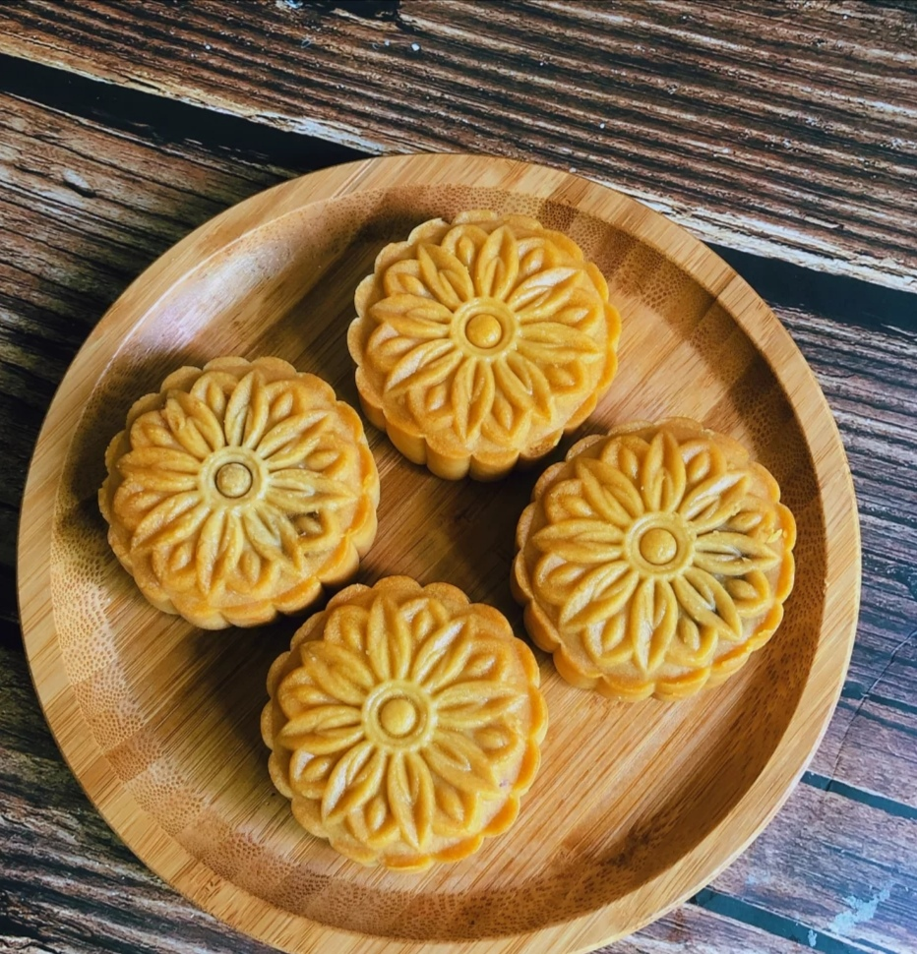
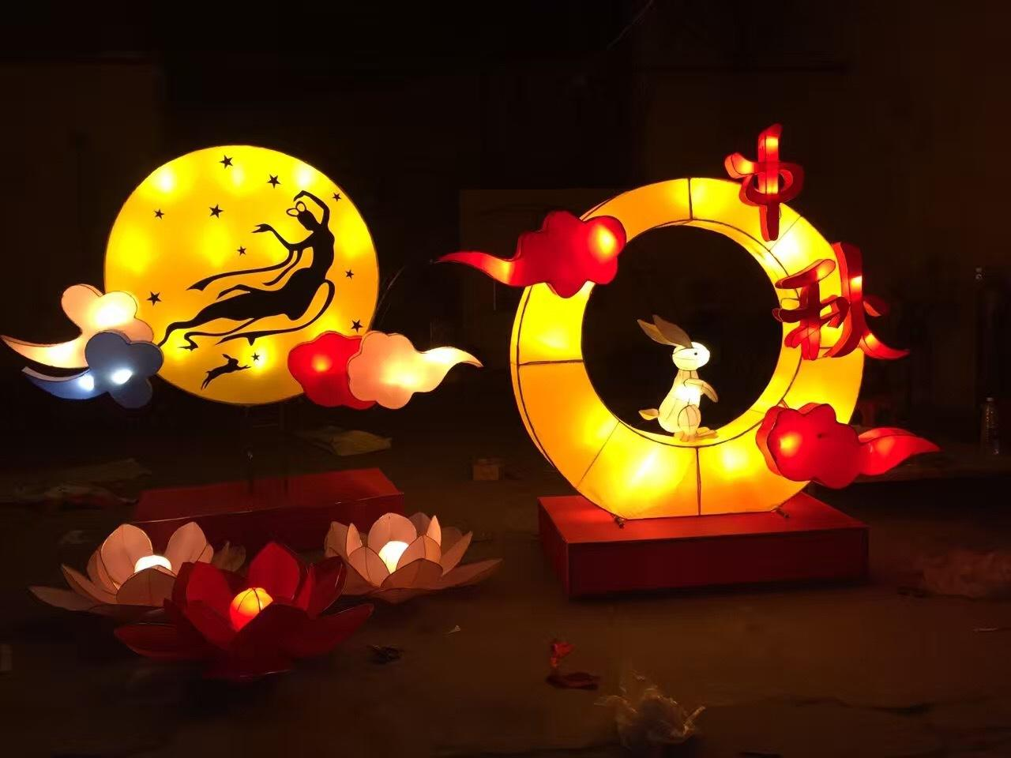
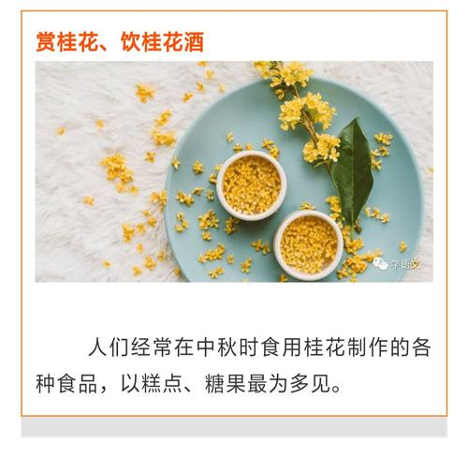
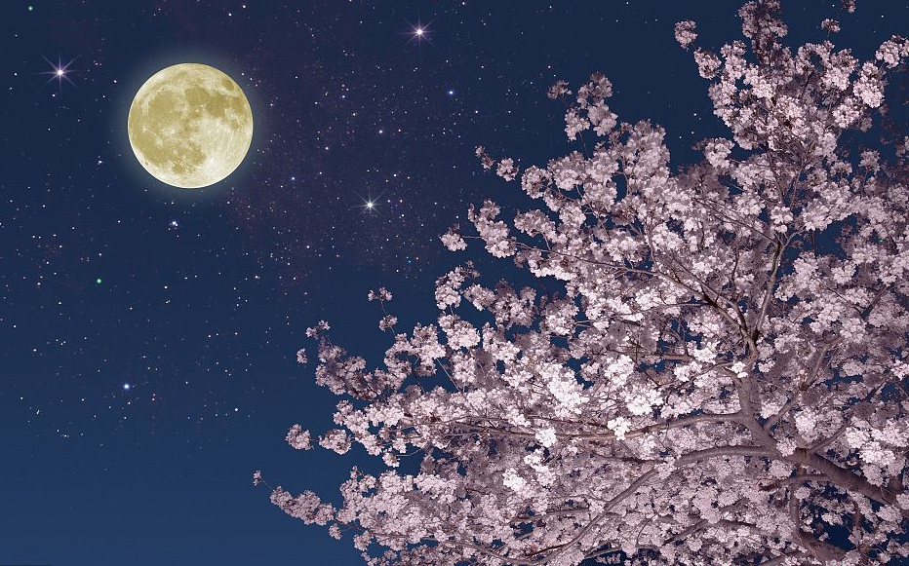
The Mid-Autumn Festival
Ⅰ Chinese Festivals
① MENG
② CHEN
Ⅱ Foreign Festivals
①LIU
②LI
Ⅲ Festival Comparison
③WU
①ZHOU
②WEI
Traditional activities : (main)
Eat moon cake
Admire the full moon
Appreciate Osmanthus, drink Osmanthus wine（赏桂花，饮桂花酒）
Play with lanterns and guess lantern riddles （玩花灯，猜灯谜）

Slide 15
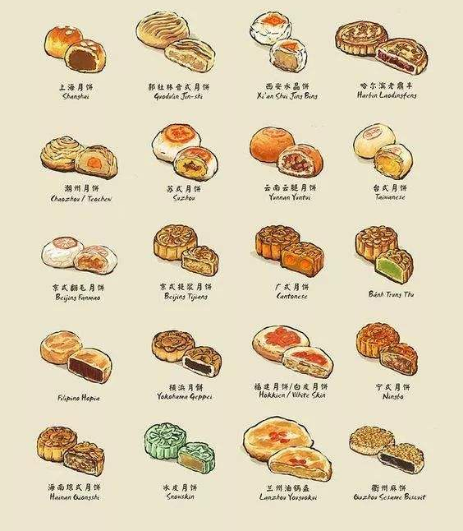
The Mid-Autumn Festival
Moon cake—what kind of moon cake do you like to eat
Ⅰ Chinese Festivals
① MENG
② CHEN
Ⅱ Foreign Festivals
①LIU
②LI
Ⅲ Festival Comparison
③WU
①ZHOU
②WEI

Slide 16
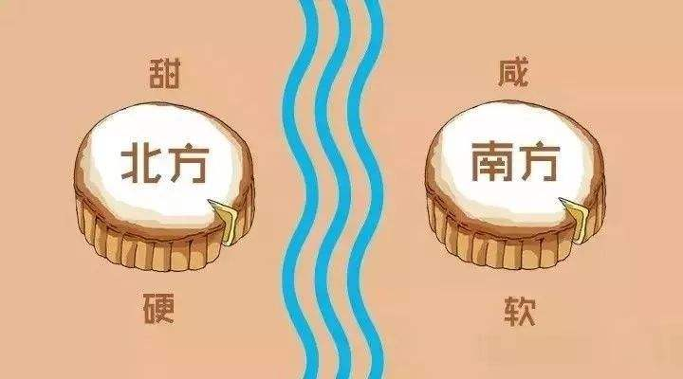
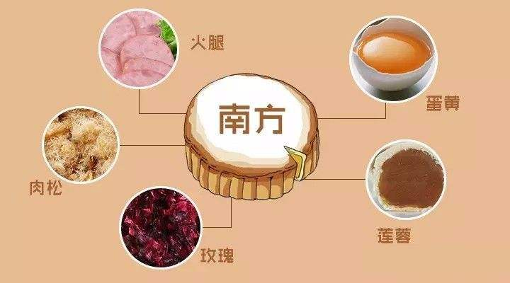
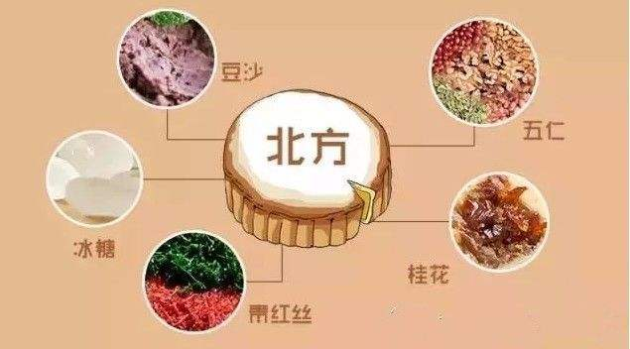
The Mid-Autumn Festival
Ⅰ Chinese Festivals
① MENG
② CHEN
Ⅱ Foreign Festivals
①LIU
②LI
Ⅲ Festival Comparison
③WU
①ZHOU
②WEI
Mooncakes are different between north and South

Slide 17
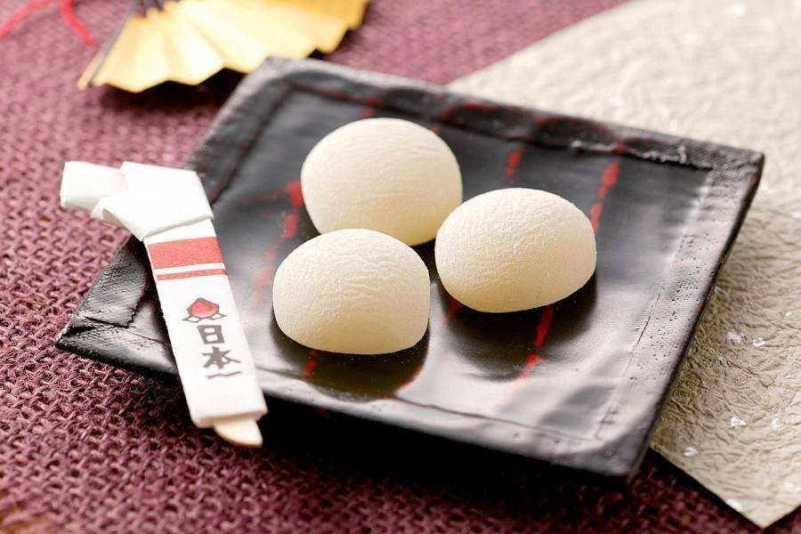
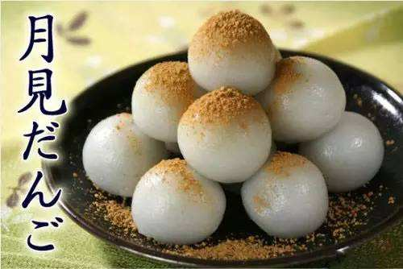
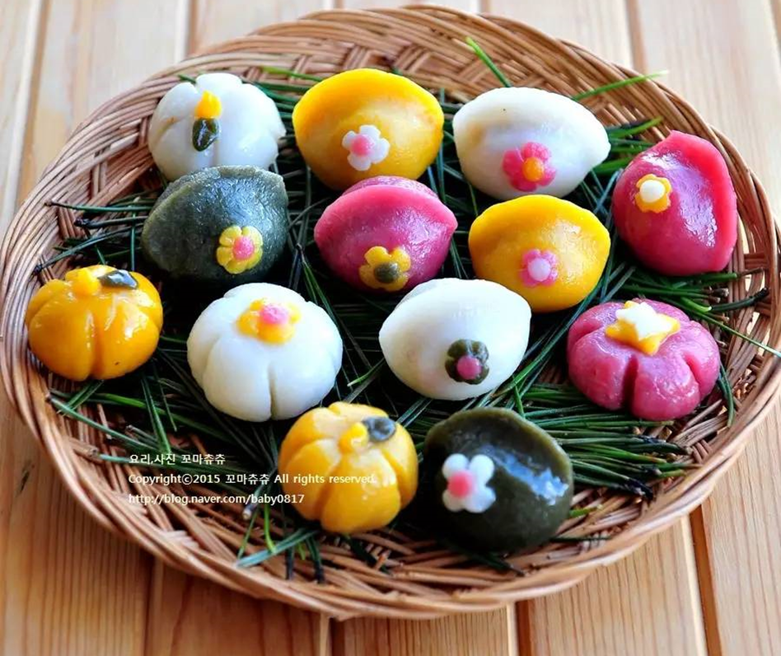
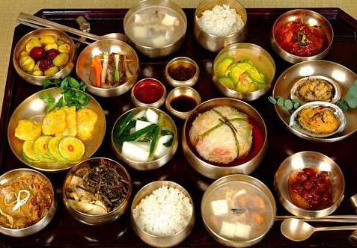
The Mid-Autumn Festival
Ⅰ Chinese Festivals
① MENG
② CHEN
Ⅱ Foreign Festivals
①LIU
②LI
Ⅲ Festival Comparison
③WU
①ZHOU
②WEI
International difference
Mid-Autumn Festival originated from China at the earliest. With the cross-regional spread, it went to different countries and communicated with the local culture, forming different festivals.

Slide 18
Bloom
Foreign Festivals
Maple Syrup Day
Easter Day

Slide 19

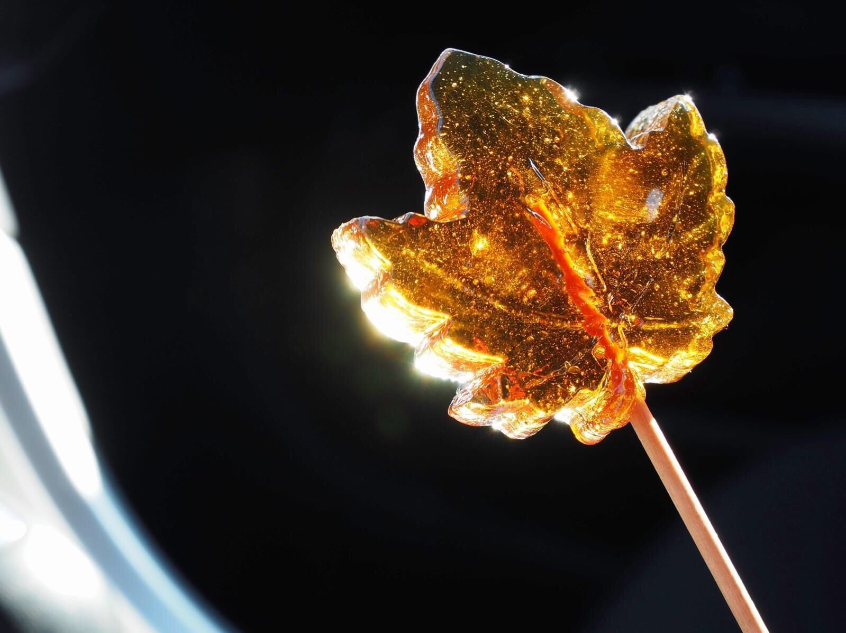
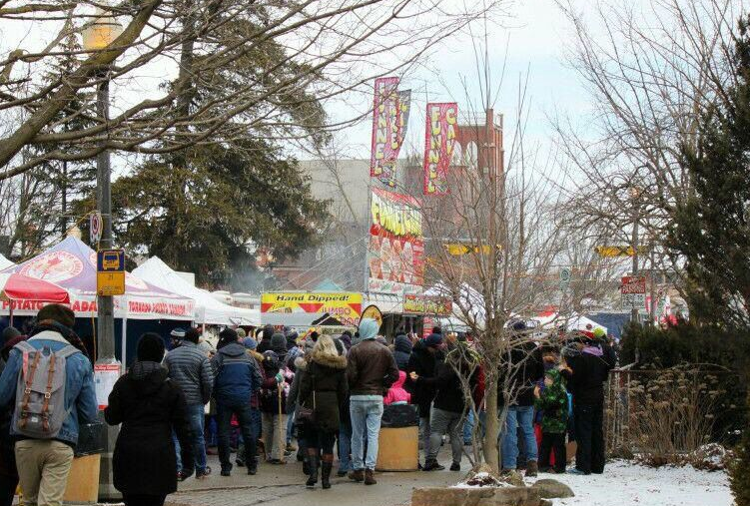
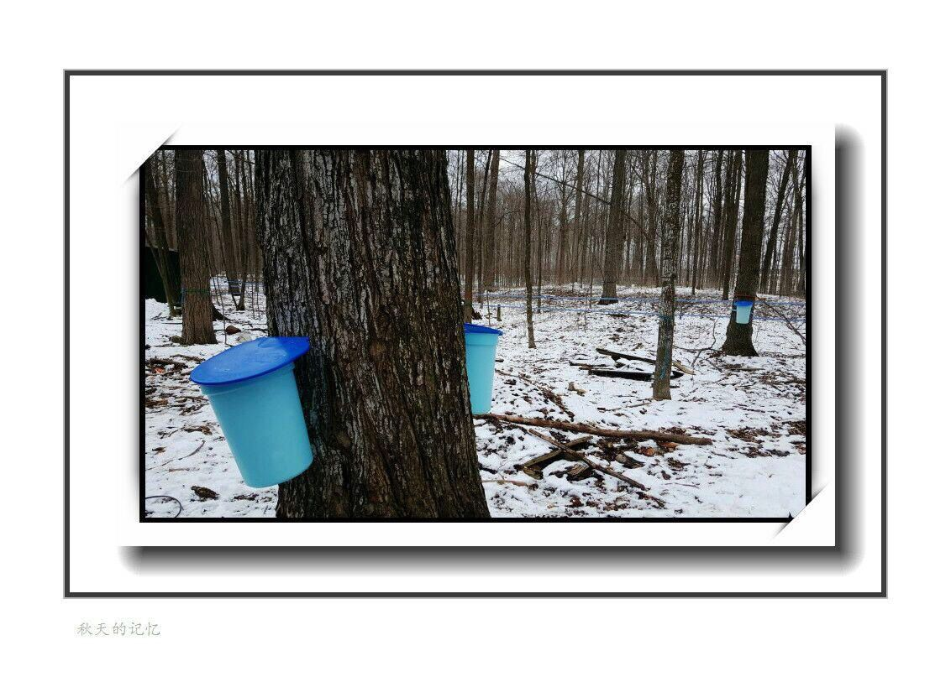
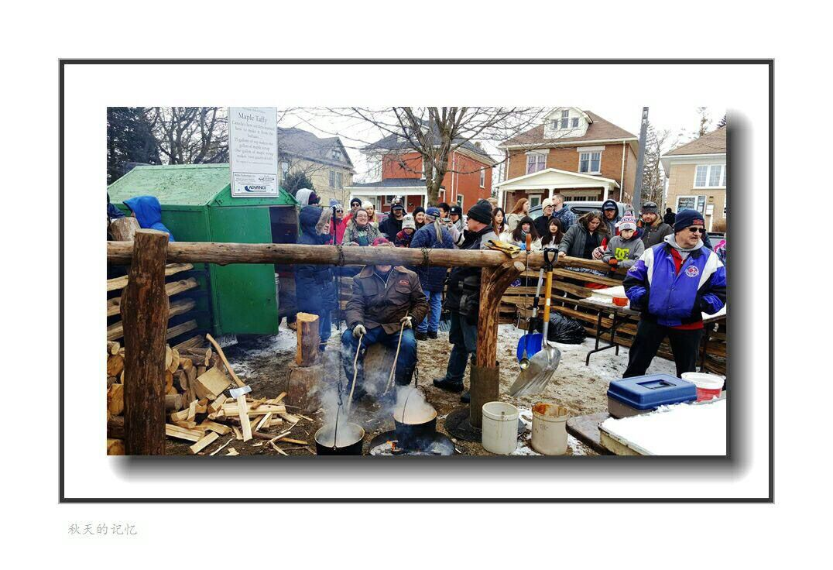
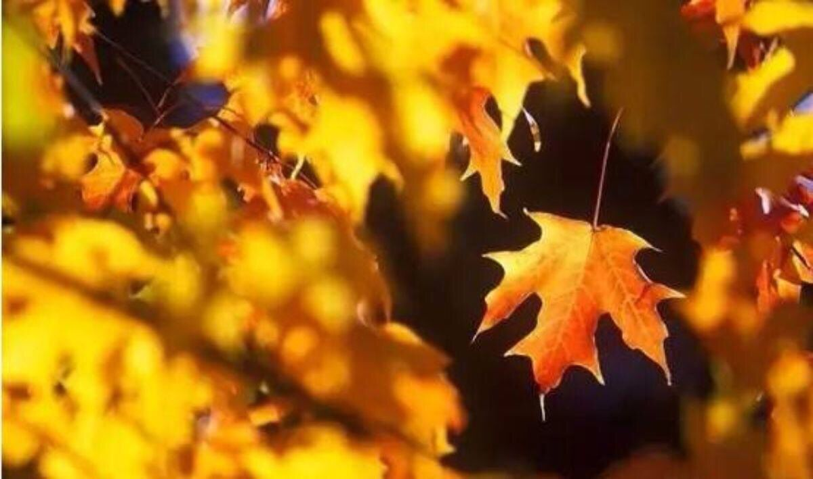
Maple Syrup Day
Ⅰ Chinese Festivals
① MENG
② CHEN
Ⅱ Foreign Festivals
①LIU
②LI
Ⅲ Festival Comparison
③WU
①ZHOU
②WEI
This thing that Canadians celebrate all over the country is called maple syrup.
During the maple Syrup Festival, people who like maple syrup will flock to Canada to have a good time in the local "Maple syrup cabin".
There are special cauldrons for cooking maple syrup in the cabin. There are specials to explain and perform the cooking process of maple syrup, and tourists are invited to taste the authentic maple syrup products.
Free maple cakes and "toffees" are sometimes served during the busy festival, where people eat pancakes and snacks, go to outdoor markets and tour the countryside in horse-car rides.
What's the sweetest holiday in the world?
I guess you could say Valentine's Day, because Valentine's Day is full of love and romance and flowers and chocolate;
The sweetest holiday, however, is in Canada, where it is called Maple Syrup Day.
The Syrup of Life
Winter in Canada is cold and long, during which there is no crops to grow. Because the early Indians had no way to farm in winter, they could only hunt meat and lacked vitamins, minerals and other nutrients, so many people died. Later, the Indians learned to make and eat maple syrup. Since then, no one in the tribe died, so the Indians called it "the syrup of life."
The sweetest of holidays

Slide 20
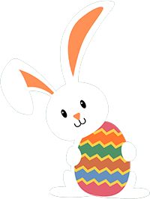
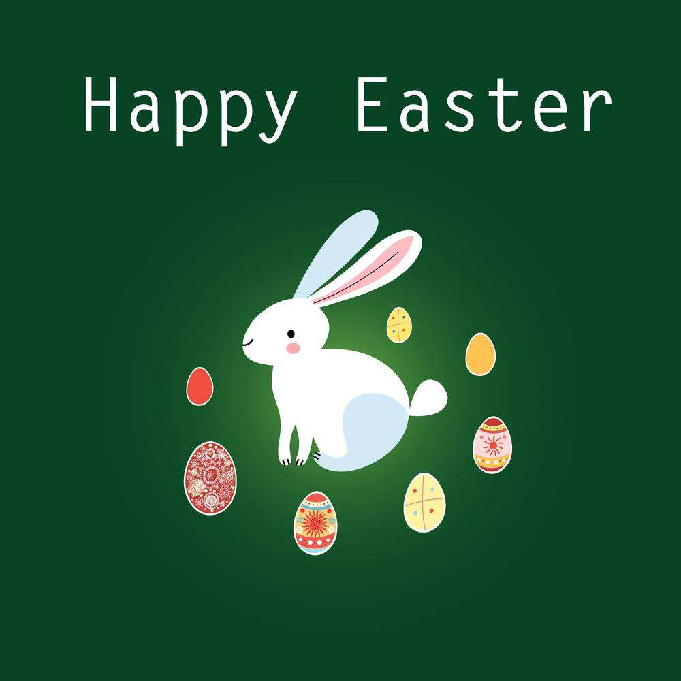
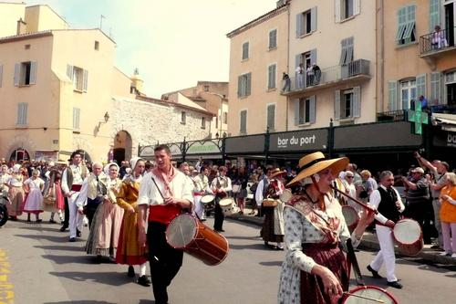
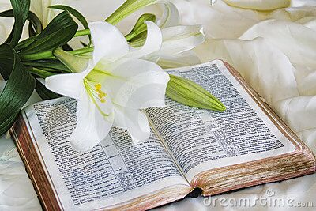
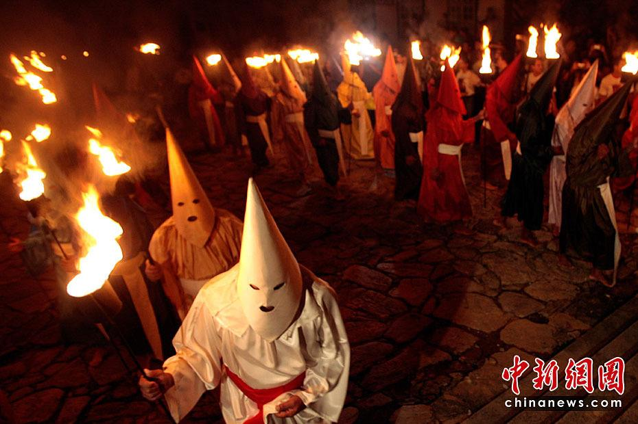
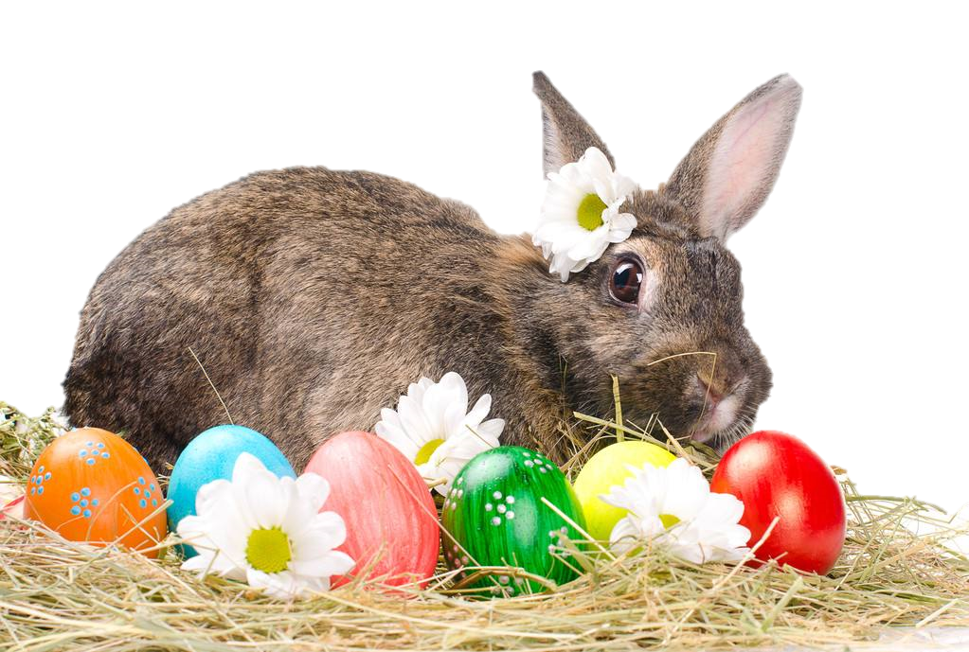
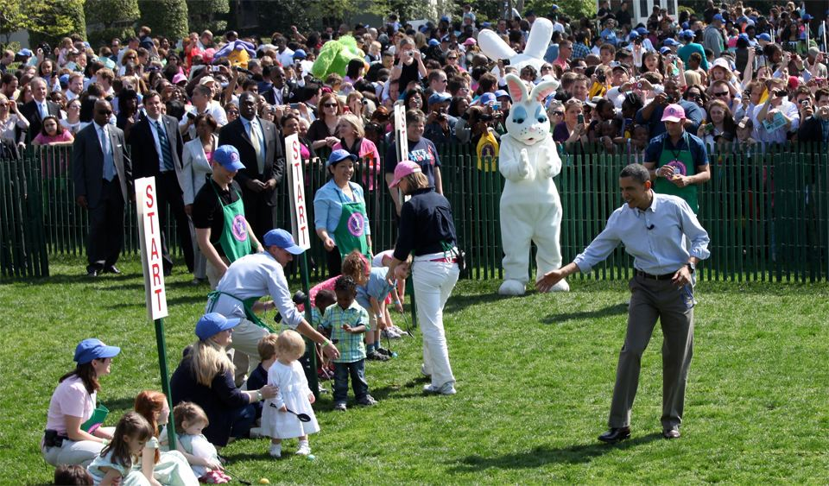
Easter Day
Ⅰ Chinese Festivals
① MENG
② CHEN
Ⅱ Foreign Festivals
①LIU
②LI
Ⅲ Festival Comparison
③WU
①ZHOU
②WEI
Festival customs
During the festival, family members get together and taste various traditional foods. Relatives and friends should congratulate each other when they meet. Eggs, fire, water and rabbits, which symbolize life, have become the mascots of Easter.
People hold many games and activities related to eggs. Children will certainly receive rabbit-shaped gifts.
On Easter Day, people also light candles in front of churches to show their sanctification, and welcome the candles to thousands of families.
Time: The first Sunday after the full moon of the vernal equinox every year
Chinese name: 复活节
English name: Easter Day
Festival food: Mutton and ham
Origin: In 325 AD, the religious conference in Nicaea stipulated that the first Sunday after the full moon of the vernal equinox was Easter every year
Significance: In memory of Jesus Christ
In many western countries, a grand festival parade is usually held on Easter.
During Easter, people also like to clean their houses thoroughly, which means that a new life begins.
On Easter, lilies can be seen everywhere. Especially, the white lily of iron cannon is regarded as "the flower of resurrection" in Christianity, representing the purity and sacredness of the heart, and it is absolutely an indispensable flower in Easter, so its English name is Easter Lily.

Slide 21
Bloom
Festival Comparison
St. Patrick's Day and The Dragon Boat Festival
Eid al-Fitr and Chinese New Year
Valentine's Day and Double Seventh Festival

Slide 22

Ⅰ Chinese Festivals
① MENG
② CHEN
Ⅱ Foreign Festivals
①LIU
②LI
Ⅲ Festival Comparison
③WU
①ZHOU
②WEI
St. Patrick's Day
AND
The Dragon Boat Festival

Slide 23
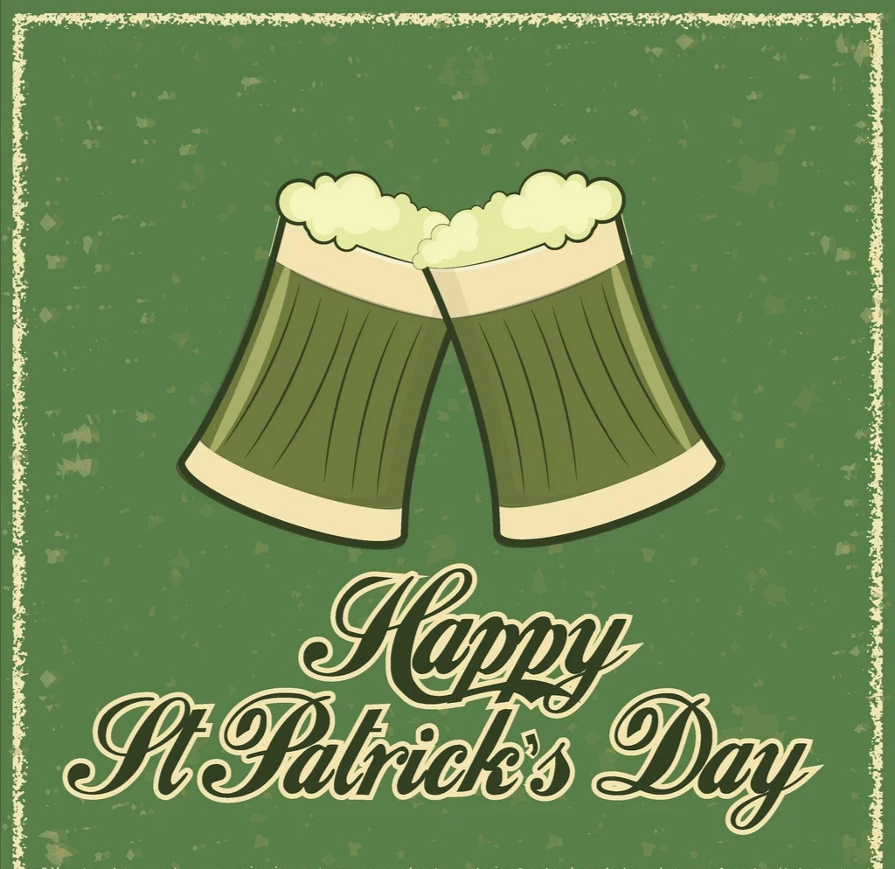
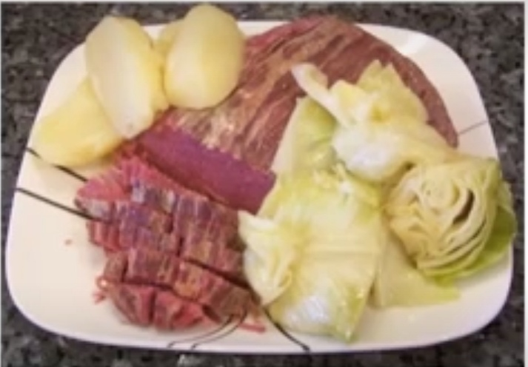
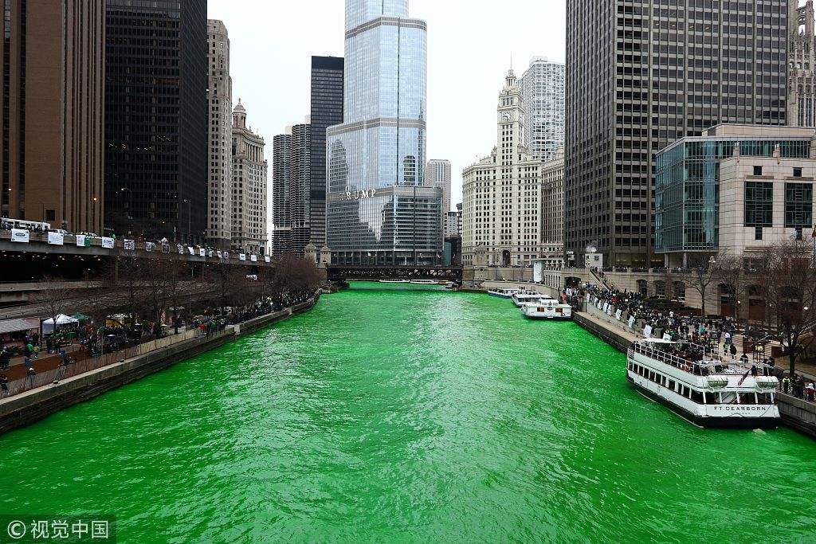
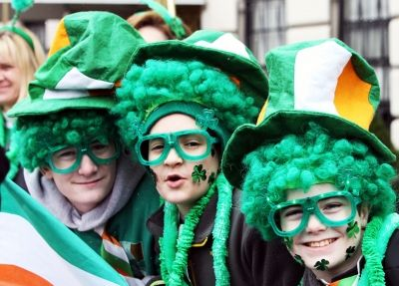
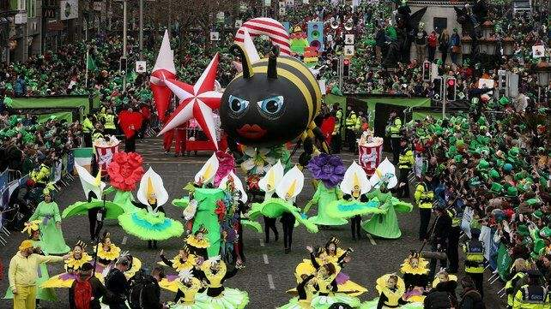
St. Patrick's Day
Ⅰ Chinese Festivals
① MENG
② CHEN
Ⅱ Foreign Festivals
①LIU
②LI
Ⅲ Festival Comparison
③WU
①ZHOU
②WEI
Date: On March 17th
Commemoration: Ireland's patron saint
——Patrick
Activities:
Eating traditional Irish meal of corned beef, cabbage, potatoes, and soda bread;
Wearing green clothes and shamrocks;
Holding St. Patrick's Day parade;
Going to church

Slide 24
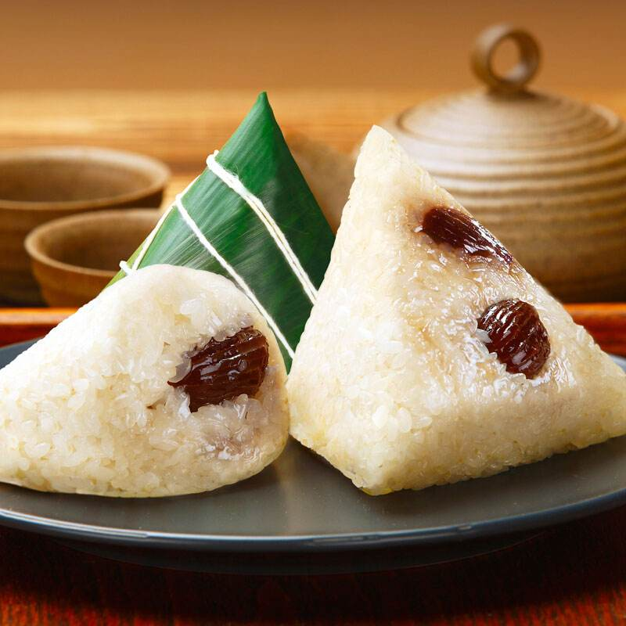
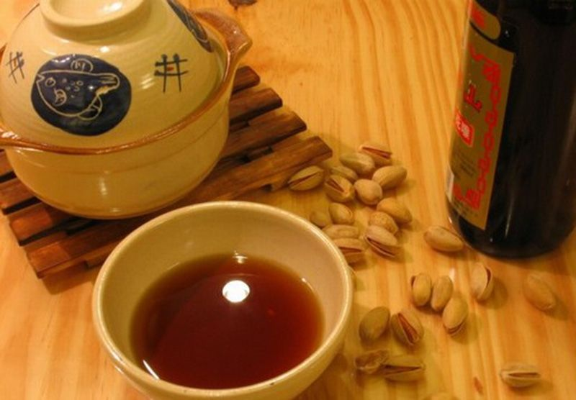
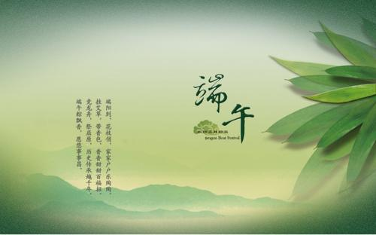
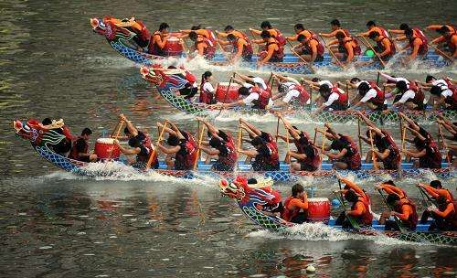

The Dragon Boat Festival
Ⅰ Chinese Festivals
① MENG
② CHEN
Ⅱ Foreign Festivals
①LIU
②LI
Ⅲ Festival Comparison
③WU
①ZHOU
②WEI
Date: The fifth day of the fifth lunar month
Commemoration: Patriotic poet and exiled official
——Qu Yuan
Activities:
Eating rice dumpling;
Drinking realgar wine;
Dragon boat racing;
Hanging wormwood and calamus

Slide 25

Ⅰ Chinese Festivals
① MENG
② CHEN
Ⅱ Foreign Festivals
①LIU
②LI
Ⅲ Festival Comparison
③WU
①ZHOU
②WEI
Valentine's Day
AND
Double Seventh Festival

Slide 26

Valentine's Day
Ⅰ Chinese Festivals
① MENG
② CHEN
Ⅱ Foreign Festivals
①LIU
②LI
Ⅲ Festival Comparison
③WU
①ZHOU
②WEI
Valentine‘s Day, also known as St.Valentine’s Day, is celebrated on February 14.
It is one of the western traditional festivals.The festival originally honored the martyrdom of two saints of the early Church of Christ, both named Valenti.
In the West, especially the United States, Valentine's Day is second only to Christmas, so Americans will hold a variety of activities on this day to celebrate the festival, many places will hold a variety of theme parties, everyone together to bless, express love, in the Hearts of Americans Valentine's Day is not only a couple's holiday.
On this day, lovers send each other chocolates, CARDS and flowers to show their love or friendship.

Slide 27

Double Seventh Festival
Ⅰ Chinese Festivals
① MENG
② CHEN
Ⅱ Foreign Festivals
①LIU
②LI
Ⅲ Festival Comparison
③WU
①ZHOU
②WEI
Qixi Festival, also known as the Seven Qiqiao Festival, seven sister festival,begging for clever festival,It is a traditional Chinese folk festival.
Qixi Festival, derived from star worship, It is named "Qixi" because it is held on the seventh night of July to worship the seventh sister.
It is the traditional custom to worship the seventh sister, pray for blessings and wishes, pray for skillful art, sit and watch the Altair and vega, pray for marriage, and store water on the Seventh Night of the Seventh Lunar month.
Double Seventh Festival

Slide 28



Valentine's Day
On this day, lovers send each other chocolates, CARDS and flowers to show their love or friendship.
Valentine's Day
Notes:
Coco 寻梦环游记

Slide 29



Double Seventh Festival
With the development of history, Qixi festival has been endowed with the beautiful love legend of "the cowherd and the Weaver Girl", which has become a symbol of love festival.
Double Seventh Festival
Notes:
celebrate life and commemorate the dead
Life go on
Similar
Good wish something

Slide 30


Double Seventh Festival VS Valentine's Day
For an American family, valentine's day, older husband to please his wife go out to dinner, young husband valentine's day in addition to arrange a family dinner, be sure to give his wife buy roses, some also want to buy a more expensive jewelry, in addition, as the daughter's father must give his daughter to buy flowers and chocolates, otherwise the daughter will be jealous.The mother also buys flowers and chocolates for her son on Valentine's Day to win his heart.But the father won't buy flowers for his son, and the mother won't buy flowers for her daughter
For Chinese, qixi festival is usually a day for couples to go out on dates and give each other gifts. Parents usually don't send flowers to their children as American parents do
Chinese people are more reserved, while Americans are more direct and open
Double Seventh Festival
Notes:
celebrate life and commemorate the dead
Life go on
Similar
Good wish something

Slide 31

Ⅰ Chinese Festivals
① MENG
② CHEN
Ⅱ Foreign Festivals
①LIU
②LI
Ⅲ Festival Comparison
③WU
①ZHOU
②WEI
Eid al-Fitr
AND
Chinese New Year

Slide 32

Eid al-Fitr
Ⅰ Chinese Festivals
① MENG
② CHEN
Ⅱ Foreign Festivals
①LIU
②LI
Ⅲ Festival Comparison
③WU
①ZHOU
②WEI
Name & Date：Eid al-Fitr or Lesser Bairam (开斋节或肉孜节)，also called the "Festival of Breaking the Fast", is a religious holiday celebrated by Muslims worldwide that marks the end of the month-long dawn-to-sunset fasting of Ramadan（伊斯兰教历的九月即斋月）. This religious Eid is the only day in the month of Shawwal（伊斯兰教历十月） during which Muslims are not permitted to fast（禁食）. The date for the start of any lunar Hijri month（回历月份） varies based on when the new moon is sighted by local religious authorities, so the day of celebration varies by locality.

Slide 33

Eid al-Fitr
Ⅰ Chinese Festivals
① MENG
② CHEN
Ⅱ Foreign Festivals
①LIU
②LI
Ⅲ Festival Comparison
③WU
①ZHOU
②WEI
History：Eid al-Fitr was originated by the Islamic prophet Muhammad. According to certain traditions, these festivals were initiated in Medina after the migration of Muhammad from Mecca. Anas, a well-known companion of the Prophet, narrated that, when the Prophet arrived in Medina, he found people celebrating two specific days in which they entertained themselves with recreation and merriment. At this, the Prophet remarked that Almighty has fixed two days of festivity instead of these for you which are better than these: Eid al-Fitr and Eid al-Adha（古尔邦节）

Slide 34

Eid al-Fitr
Ⅰ Chinese Festivals
① MENG
② CHEN
Ⅱ Foreign Festivals
①LIU
②LI
Ⅲ Festival Comparison
③WU
①ZHOU
②WEI
Regions：
Middle East: Jordan, Saudi Arabia, Iran, Turkey, Afghanistan
Africa: Egypt, Tunisia, Somalia
South Asia: India, Pakistan, Bangladesh
Southeast Asia: Indonesia, Malaysia, Singapore, Brunei, Thailand, Myanmar, Philippines,
East Asia：China
Europe: Greece, United Kingdom
North America: United States

Slide 35

Eid al-Fitr
Ⅰ Chinese Festivals
① MENG
② CHEN
Ⅱ Foreign Festivals
①LIU
②LI
Ⅲ Festival Comparison
③WU
①ZHOU
②WEI
Take Saudi Arabia and China as two examples:
Saudis decorate their homes and prepare sumptuous（丰盛的）meals for family and friends. They prepare new clothes and shoes for the festival. Eid festivities in Saudi Arabia may vary culturally depending on the region, but one common thread in all celebrations is generosity and hospitality. It is a common Saudi tradition for families to gather at the patriarchal home after the Eid prayers. Before the special Eid meal is served, young children will line up in front of each adult family member, who dispense money as gifts to the children.

Slide 36

Eid al-Fitr
Ⅰ Chinese Festivals
① MENG
② CHEN
Ⅱ Foreign Festivals
①LIU
②LI
Ⅲ Festival Comparison
③WU
①ZHOU
②WEI
Take Saudi Arabia and China as two examples:
In China，out of 56 officially recognized ethnic groups, Eid al-Fitr is celebrated by at least 10 ethnic groups that are predominantly Muslim. These groups are said to over 18 million. It is also a public holiday in China in certain regions, including two Province Prefecture Level regions, Ningxia and Xinjiang. All residents in these areas, regardless of religion, are entitled to either a one-day or three-day official holiday. Outside the Muslim-majority regions, only Muslims are entitled to a one-day holiday. In Xinjiang province, Eid al-Fitr is even celebrated by the Han Chinese population. During the holiday, supplies of mutton, lamb and beef are distributed to households as part of a welfare program funded by government agencies, public and private institutions, and businesses. In Yunnan, Muslim populations are spread throughout the region. On Eid al-Fitr, they will conduct readings from the Quran and clean the tomb, reminiscent of the historic annual Chinese Qingming festival, in which people go to their ancestors' graves, sweep and clean the area, and make food offerings.

Slide 37


Chinese New Year
Ⅰ Chinese Festivals
① MENG
② CHEN
Ⅱ Foreign Festivals
①LIU
②LI
Ⅲ Festival Comparison
③WU
①ZHOU
②WEI
Time: It is based on the lunar calendar and usually falls between 21 January and 20 February every year.
Customs: Yangko, Stilt shows, temple fair, enjoy watching beautiful lanterns, set off firecrackers, paste spring couplets, stay up late on New Year’ Eve, have a family reunion dinner, Pay a new year call, offer sacrifices to the kitchen god, sweep dust, cut paper-cuttings, purchase for the Spring Festival, give children lucky money as the New Year’ s gift. Eat rice cakes and dumplings.

Slide 38

Chinese New Year
Ⅰ Chinese Festivals
① MENG
② CHEN
Ⅱ Foreign Festivals
①LIU
②LI
Ⅲ Festival Comparison
③WU
①ZHOU
②WEI
Activities: In China, the most exciting part of the festival is Chinese New Year’s Eve, when people stay up late at night and set off fireworks. In China, it is very common for older people to put money in red envelopes and give to youngsters.

Slide 39

Chinese New Year
Ⅰ Chinese Festivals
① MENG
② CHEN
Ⅱ Foreign Festivals
①LIU
②LI
Ⅲ Festival Comparison
③WU
①ZHOU
②WEI
History: According to tales and legends, the beginning of the Chinese New Year started with a mythical beast called the Nian (a beast that lives under the sea or in the mountains) during the annual Spring Festival. The Nian would eat villagers, especially children in the middle of the night. One year, all the villagers decided to go hide from the beast. An old man, appeared before the villagers went into hiding and said that he would stay the night, and would get revenge on the Nian. All the villagers thought he was insane. The old man put red papers up and set off firecrackers. The day after, the villagers came back to their town and saw that nothing had been destroyed. They assumed that the old man was a deity who came to save them. The villagers then understood that Yanhuang had discovered that the Nian was afraid of the color red and loud noises. So the tradition grew that when New Year was approaching, the villagers would wear red clothes, hang red lanterns, and red spring scrolls on windows and doors. People also used firecrackers to frighten away the Nian. From then on, Nian never came to the village again.

Slide 40


Chinese New Year
Ⅰ Chinese Festivals
① MENG
② CHEN
Ⅱ Foreign Festivals
①LIU
②LI
Ⅲ Festival Comparison
③WU
①ZHOU
②WEI
Related countries: Chinese New year is celebrated in China as well as neighboring countries like Singapore, Malaysia, Thailand, the Philippines, South Korea, and all around the world where there are Chinese communities.
Significance: It is one of the most important and biggest festivals in traditional Chinese culture, and one of the longest holidays, lasting up to 7 days.

Slide 41

Chinese New Year
Ⅰ Chinese Festivals
① MENG
② CHEN
Ⅱ Foreign Festivals
①LIU
②LI
Ⅲ Festival Comparison
③WU
①ZHOU
②WEI
The nightmare of youngsters!

